Slide 1
Robust Data-Driven Optimization using CVaR and SVC
AYUSH SINGH, 2021MT10899
Supervisor-
Prof. Aparna Mehra

Slide 2
Introduction
In finance, portfolio construction or asset allocation is one of the most frequent problems faced by practitioners. This was first introduced by Markowitz in his Portfolio Theory
There are many biases involved when a person chooses stocks manually. Hence a more quantitative and formulaic way to choose investments is necessary
A highly utilized method to reduce risk is diversification. An automated method to classify or cluster assets would be very useful and essential to investment decision-making and the practice of diversification.
The stocks would be separated into groups via a clustering method that maximizes similarity within groups and minimizes similarity between groups.
However estimation of the covariance matrix in the Markowitz model, is a tediouss task and leads to large scale difficulties while solving the large scale quadratic programming model.

Slide 3
In a traditional PO model, one may come across parameters that are not known with complete certainty, and we may employ some nominal values to approximate these parameters.
The input asset returns taken in portfolio selection problems under the discrete distribution of returns are generally taken as the daily/weekly closing returns, thus ignoring the intra-day/weekly volatility of the asset prices. This may lead to incorrect estimation of expected portfolio returns.
Using nominal values for these uncertain parameters may result in suboptimal solutions and, thus, incorrect out-of-sample estimates. For this reason, portfolio managers may resort to robust optimization (RO) by constructing un- certainty sets for such parameters.

Slide 4
We address this uncertainty of expected asset returns by capturing the uncertain returns in a sphere of minimum radius and excluding an appropriate amount of outliers through a user-controlled regularization parameter in SVC. The proposed technique at- tempts to construct a compact and flexible uncertainty set for expected asset returns that has the ability to include probable realizations of asset returns and adapts to the structure of the available data.
The developed uncertainty set is integrated to the nominal PO model with CVaR measure to yield a robust formulation of the proposed model. The developed technique requires solving two computationally tractable optimization problems: the first model is a quadratic programming problem that appropriately deter- mines support vectors based on the regularization parameter, and the second model solves the robust LP PO model with CVaR risk measure.
Thus, the proposed technique not only constructs a data-driven convex uncertainty set for the asset expected returns but also allows the investor to obtain robust portfolios through a simple LP model.

Slide 5
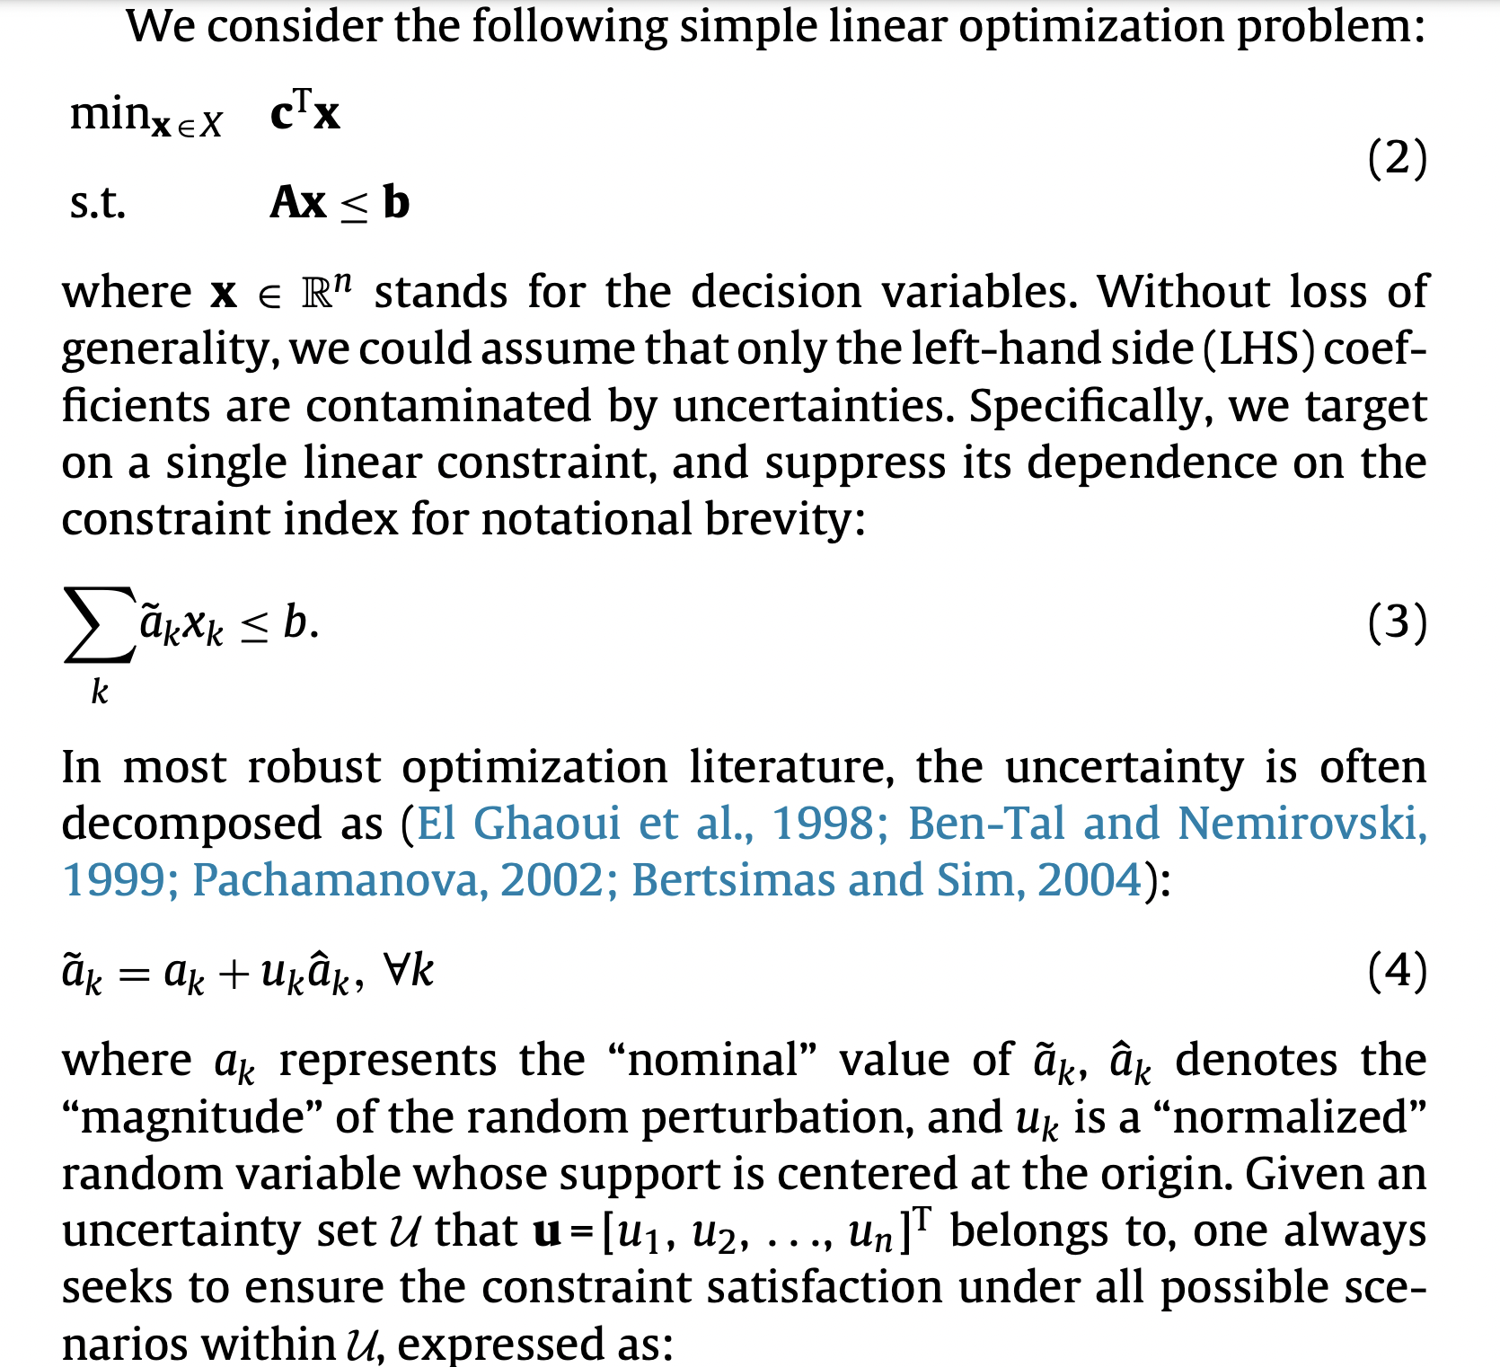

Slide 6
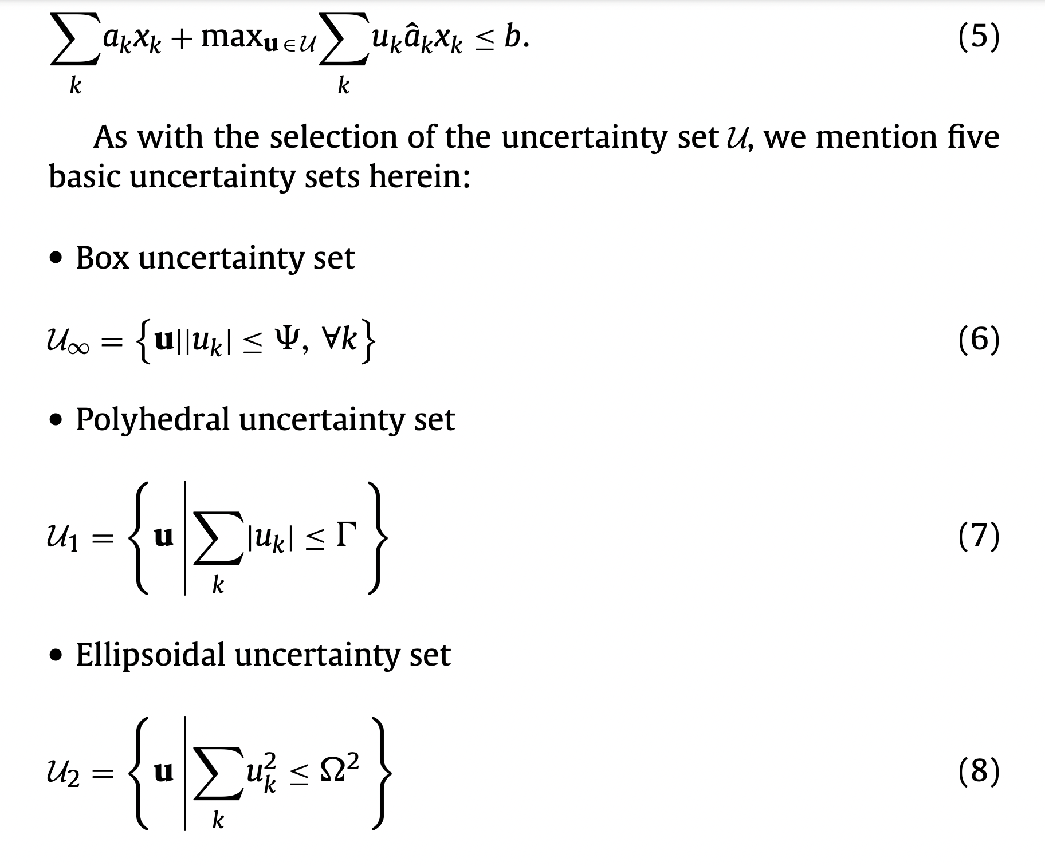

Slide 7
Our Risk Measure – CVaR!

Slide 8
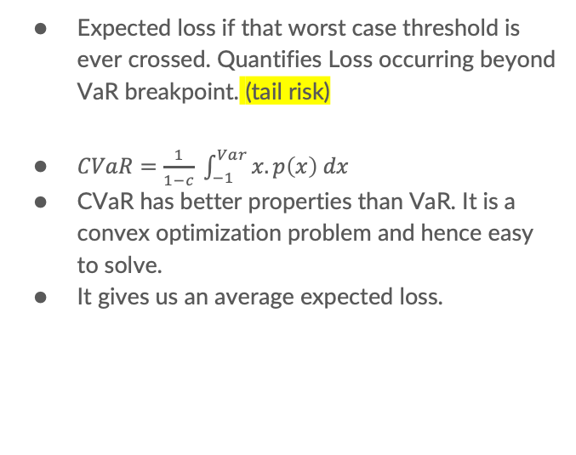
VaR CVaR
Max Loss an investment portfolio may suffer in a given time frame with a certain level of confidence
It gives us a range of expected losses.
Expected loss if that worst case threshold is ever crossed. Quantifies Loss occurring beyond VaR breakpoint. (tail risk)
$CVaR=\frac{1}{1−c} \int_{−1}^{Var}{x.p\left(x\right) dx}$
CVaR has better properties than VaR. It is a convex optimization problem and hence easy to solve.
It gives us an average expected loss.

Slide 9
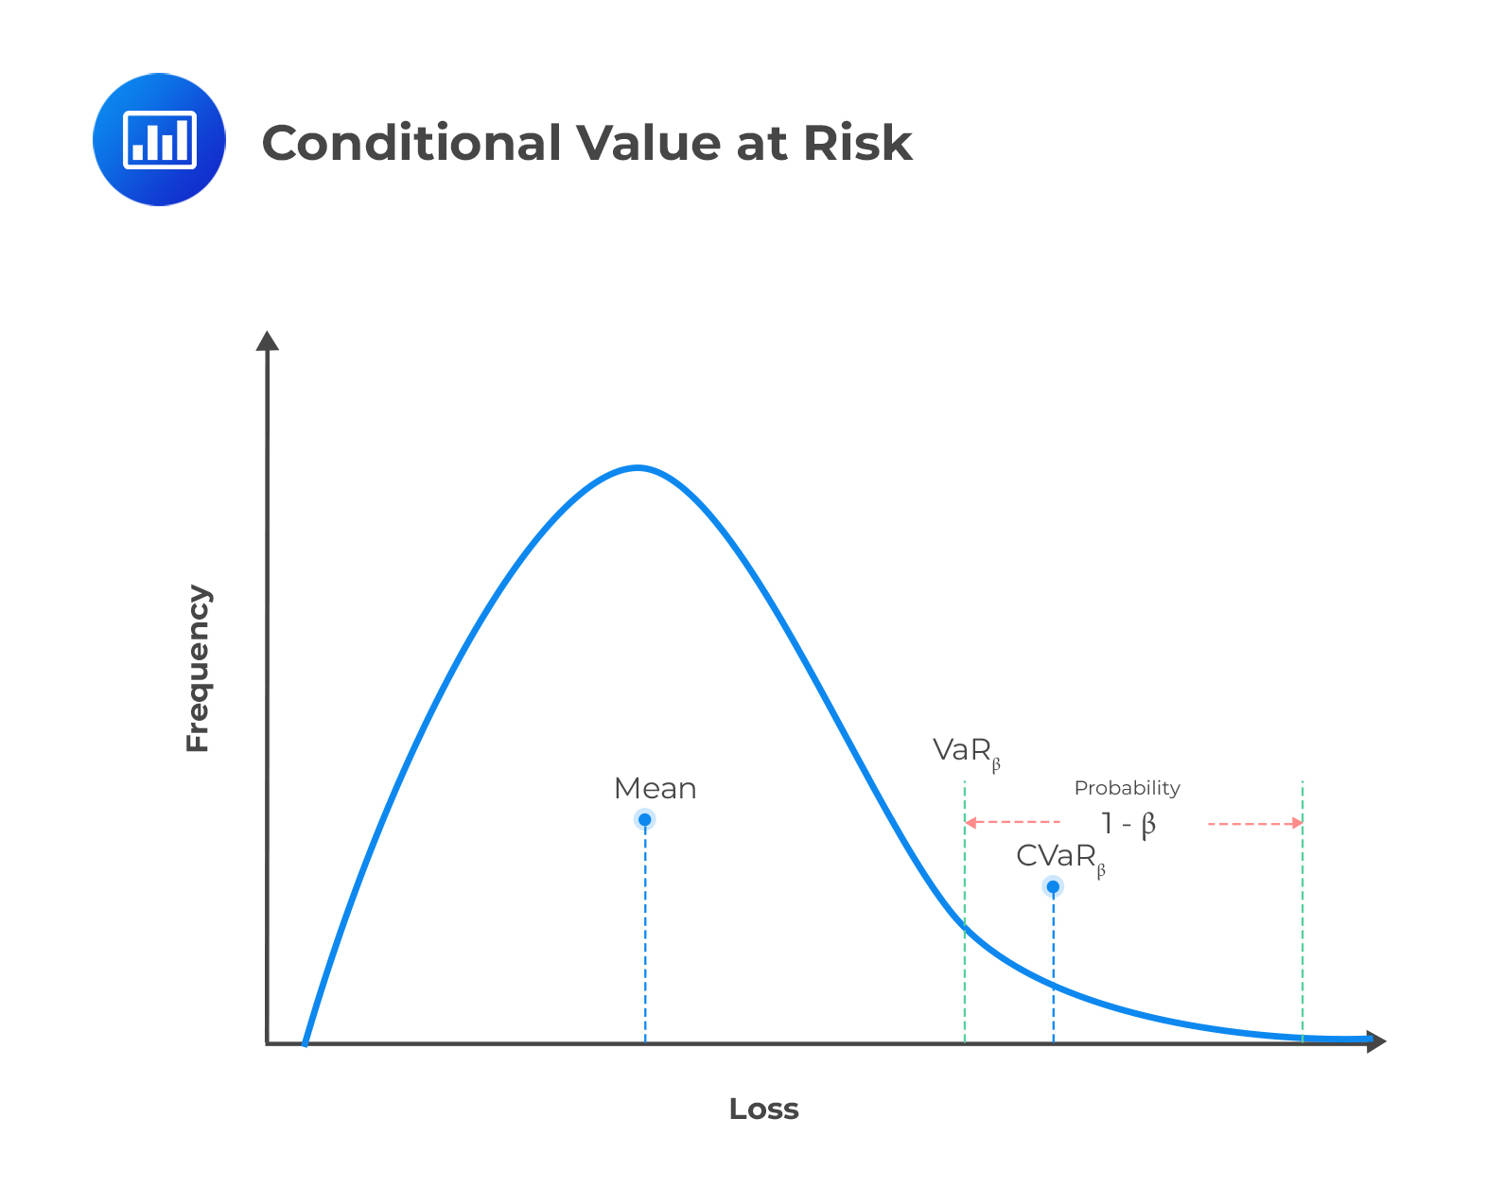

Slide 10
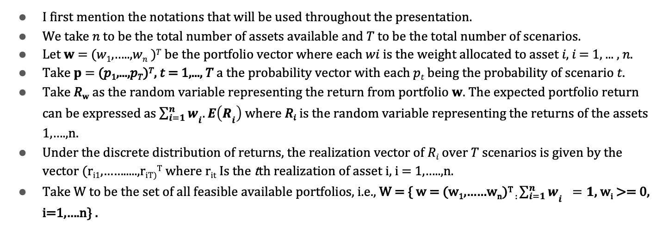
Notations
I first mention the notations that will be used throughout the presentation.
We take 𝑛 to be the total number of assets available and 𝑇 to be the total number of scenarios.
Let 𝐰 = (𝑤₁,…..,𝑤_{𝑛} )^{𝑇} be the portfolio vector where each 𝑤𝑖 is the weight allocated to asset 𝑖, 𝑖 = 1, ... , 𝑛.
Take 𝐩 = (𝑝₁,...,𝑝_{𝑇})^{𝑇}, 𝑡 = 1,..., 𝑇 a the probability vector with each 𝑝_{𝑡} being the probability of scenario 𝑡.
Take 𝑅_{𝐰} as the random variable representing the return from portfolio 𝐰. The expected portfolio return can be expressed as $\sum_{i=1}^{n}{w­­_{i}.E\left(R­_{i}\right)}$ where 𝑅_{𝑖} is the random variable representing the returns of the assets 1,….,n.
Under the discrete distribution of returns, the realization vector of 𝑅_{𝑖} over 𝑇 scenarios is given by the vector (r_{i1},…….....,r_{iT)}^{T} where r_{it} Is the tth realization of asset i, i = 1,…..,n.
Take W to be the set of all feasible available portfolios, i.e., W = { w = (w₁,……w_{n})^{T} : $\sum_{i=1}^{n}{w­­_{i} =1}$, w_{i} >= 0, i=1,….n} .

Slide 11
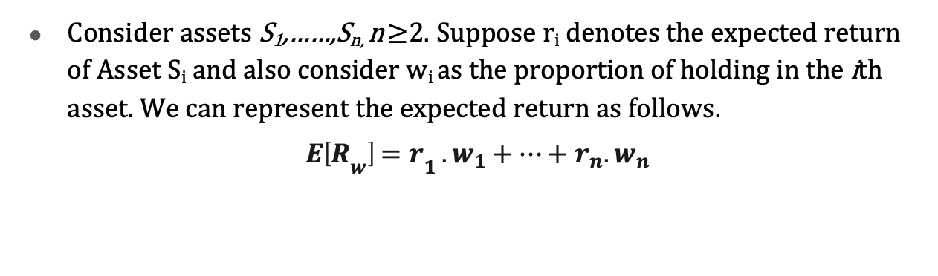
Model Construction
Consider assets S₁,……,S_{n,} n ≥2. Suppose r_{i­} denotes the expected return of Asset S_{i} and also consider w_{i} as the proportion of holding in the ith asset. We can represent the expected return as follows.
$E\left[R­_{w}\right]=r­­_{1 }.w_{1}+…+r_{n}{. w}_{n}$

Slide 12
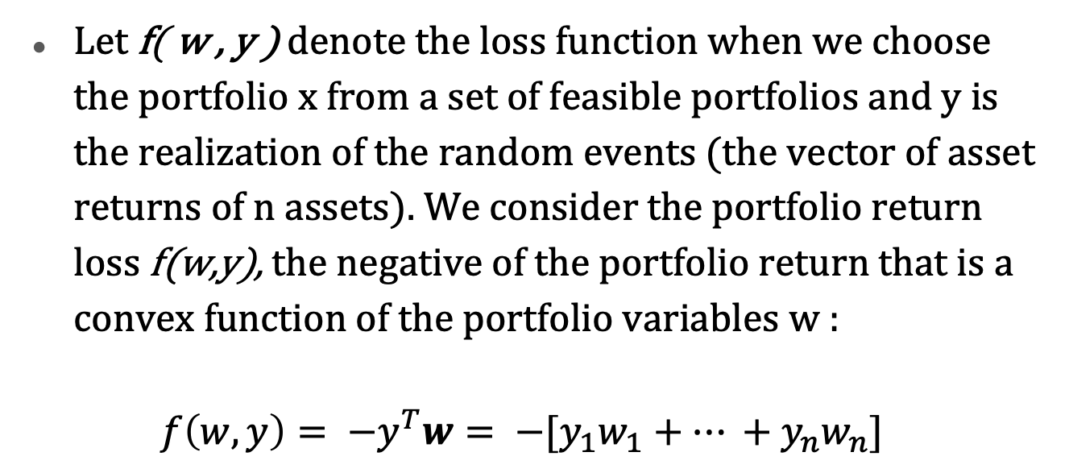
Let f( w , y ) denote the loss function when we choose the portfolio x from a set of feasible portfolios and y is the realization of the random events (the vector of asset returns of n assets). We consider the portfolio return loss f(w,y), the negative of the portfolio return that is a convex function of the portfolio variables w :
$$f\left(w,y\right)= −y^{T}w= −[y_{1}w_{1}+… +y_{n}w_{n}]$$

Slide 13
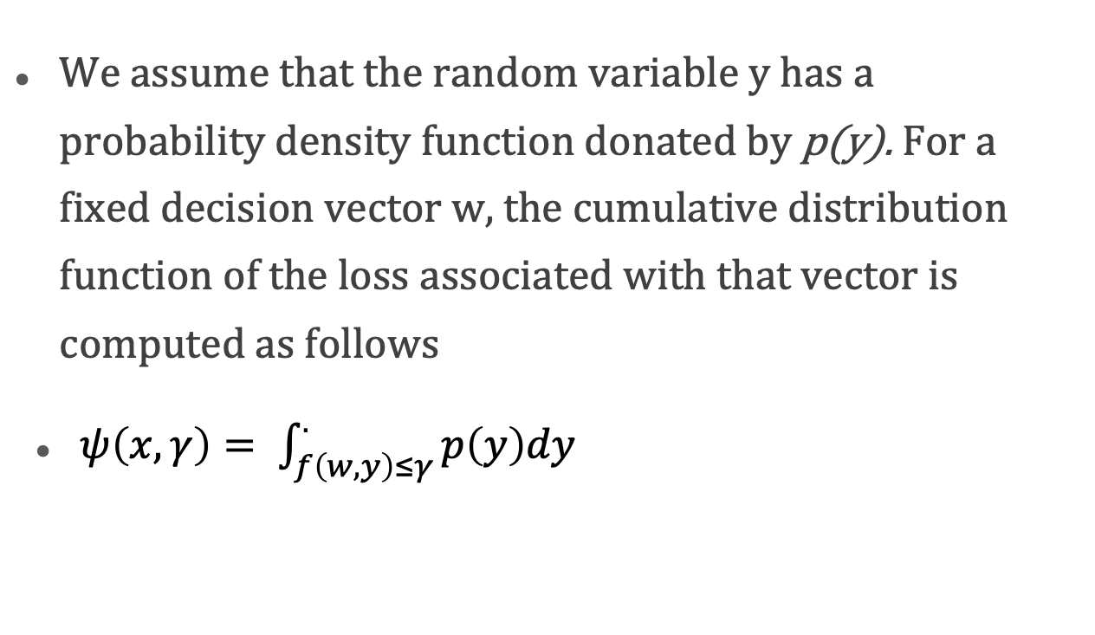
We assume that the random variable y has a probability density function donated by p(y). For a fixed decision vector w, the cumulative distribution function of the loss associated with that vector is computed as follows
$ψ\left(x,γ\right)= \int_{f\left(w,y\right)≤γ}^{.}{p\left(y\right)dy}$

Slide 14
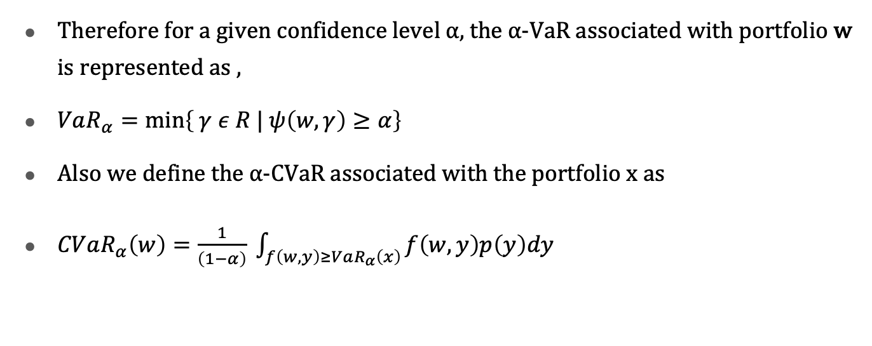
Therefore for a given confidence level ⍺, the ⍺-VaR associated with portfolio w is represented as ,
$VaR_{α}=\min\left\{ γ ε R | ψ\left(w,γ\right)≥α\right\}$
Also we define the ⍺-CVaR associated with the portfolio x as
$CVaR_{α}\left(w\right)=\frac{1}{\left(1−α\right)} \int_{f\left(w,y\right)≥VaR_{α}\left(x\right)}{f\left(w,y\right)p\left(y\right)dy}$

Slide 15
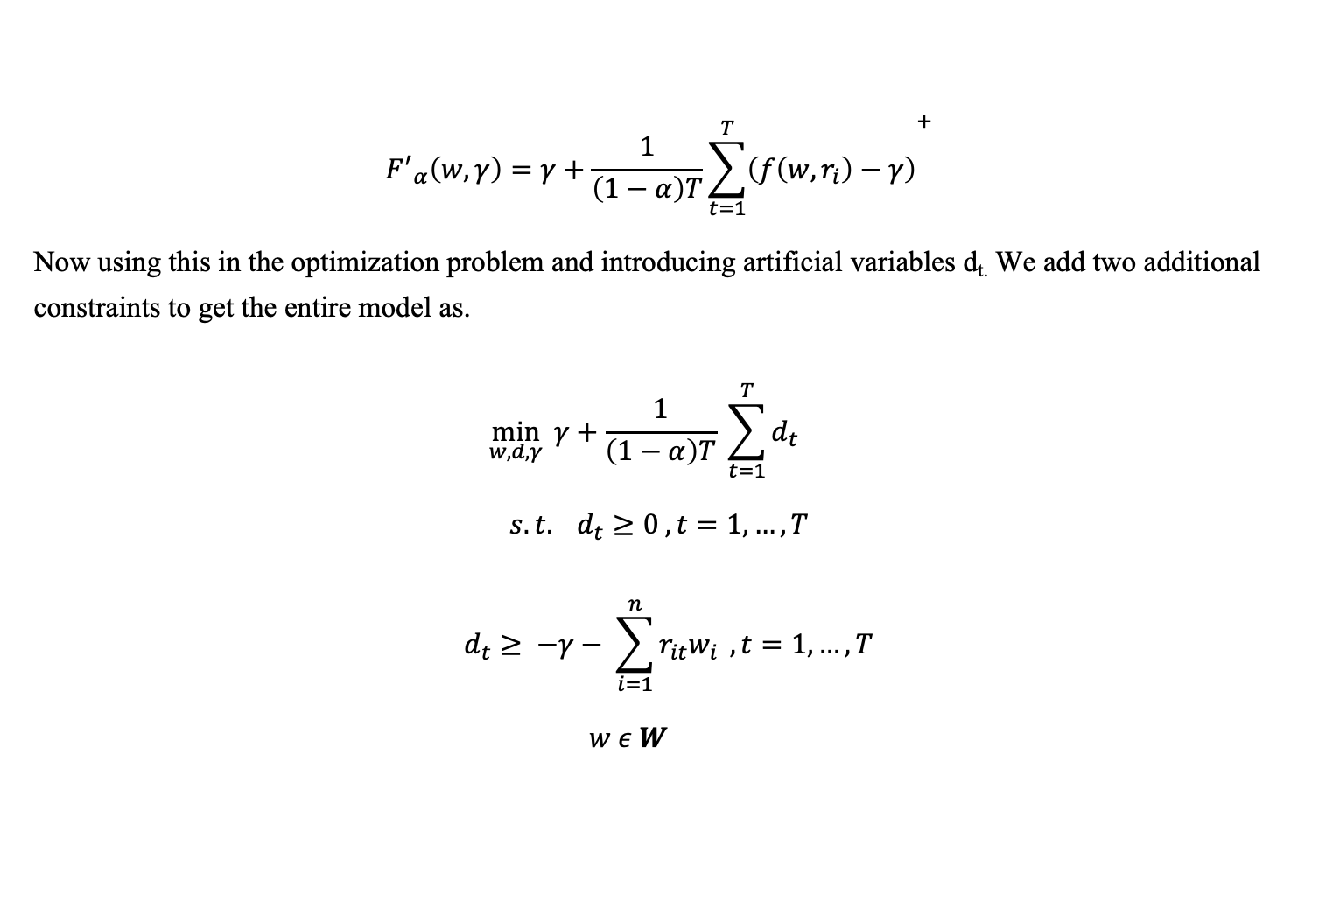
$${F^{′}}_{α}\left(w,γ\right)=γ+\frac{1}{\left(1−α\right)T}{\sum_{t=1}^{T}{\left(f\left(w,r_{i}\right)−γ\right)}}^{+}$$
Now using this in the optimization problem and introducing artificial variables d_{t.} We add two additional constraints to get the entire model as.
$$\min_{w,d,γ}{ γ+\frac{1}{\left(1−α\right)T} \sum_{t=1}^{T}{d_{t } }}$$
$$s.t. d_{t}≥0 , t=1,…, T$$
$$d_{t}≥ −γ− \sum_{i=1}^{n}{r_{it}w_{i}} , t=1,…, T$$
$w ε W$

Slide 16
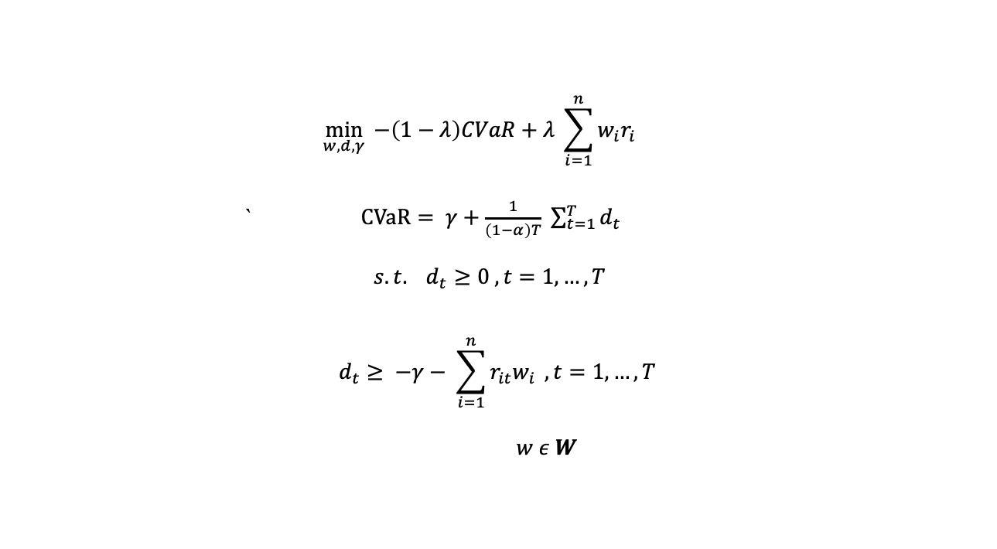
Like the mean-variance model, we can construct a portfolio, which maximizes the expected return for some level of risk (in this case, expressed using CVaR). If we introduce a risk aversion coefficient λ𝜆, then the mean-CVaR portfolio optimisation model can be written:
$$\min_{w,d,γ}{ −\left(1−λ\right)CVaR+λ \sum_{i=1}^{n}{w_{i}r_{i} }}$$
` $CVaR= γ+\frac{1}{\left(1−α\right)T} \sum_{t=1}^{T}{d_{t } }$
$$s.t. d_{t}≥0 , t=1,…, T$$
$$d_{t}≥ −γ− \sum_{i=1}^{n}{r_{it}w_{i}} , t=1,…, T$$
$w ε W$

Slide 17
To illustrate the application of CVaR in a portfolio setting, I download data from Yahoo on 5 ETFs, tracking four equity markets and one aggregated bond market respectively. I use the brilliant Python library PuLP to formulate a linear optimization model, and iteratively find the optimal portfolio for different risk aversions, 𝜆 . Here I took 𝜆=1.

Slide 18
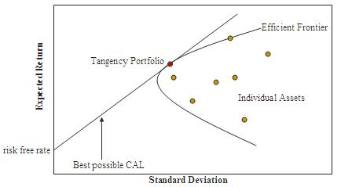
Efficient Frontier
Set of optimal portfolios that maximise returns for a given amount of risk or those portfolios with minimum risk for a given amount of expected returns.
Portfolios that lie below that efficient frontier are sub-optimal as they do not maximise the returns or minimise the risk.

Slide 19
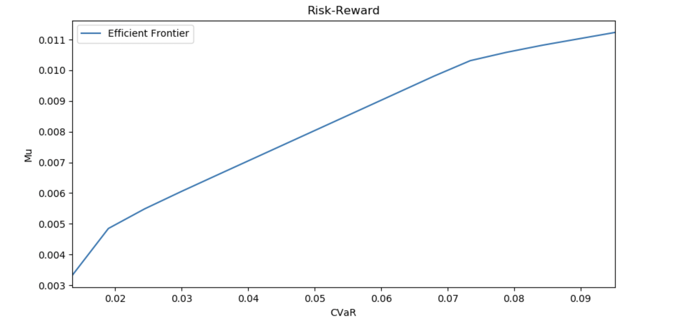

Slide 20
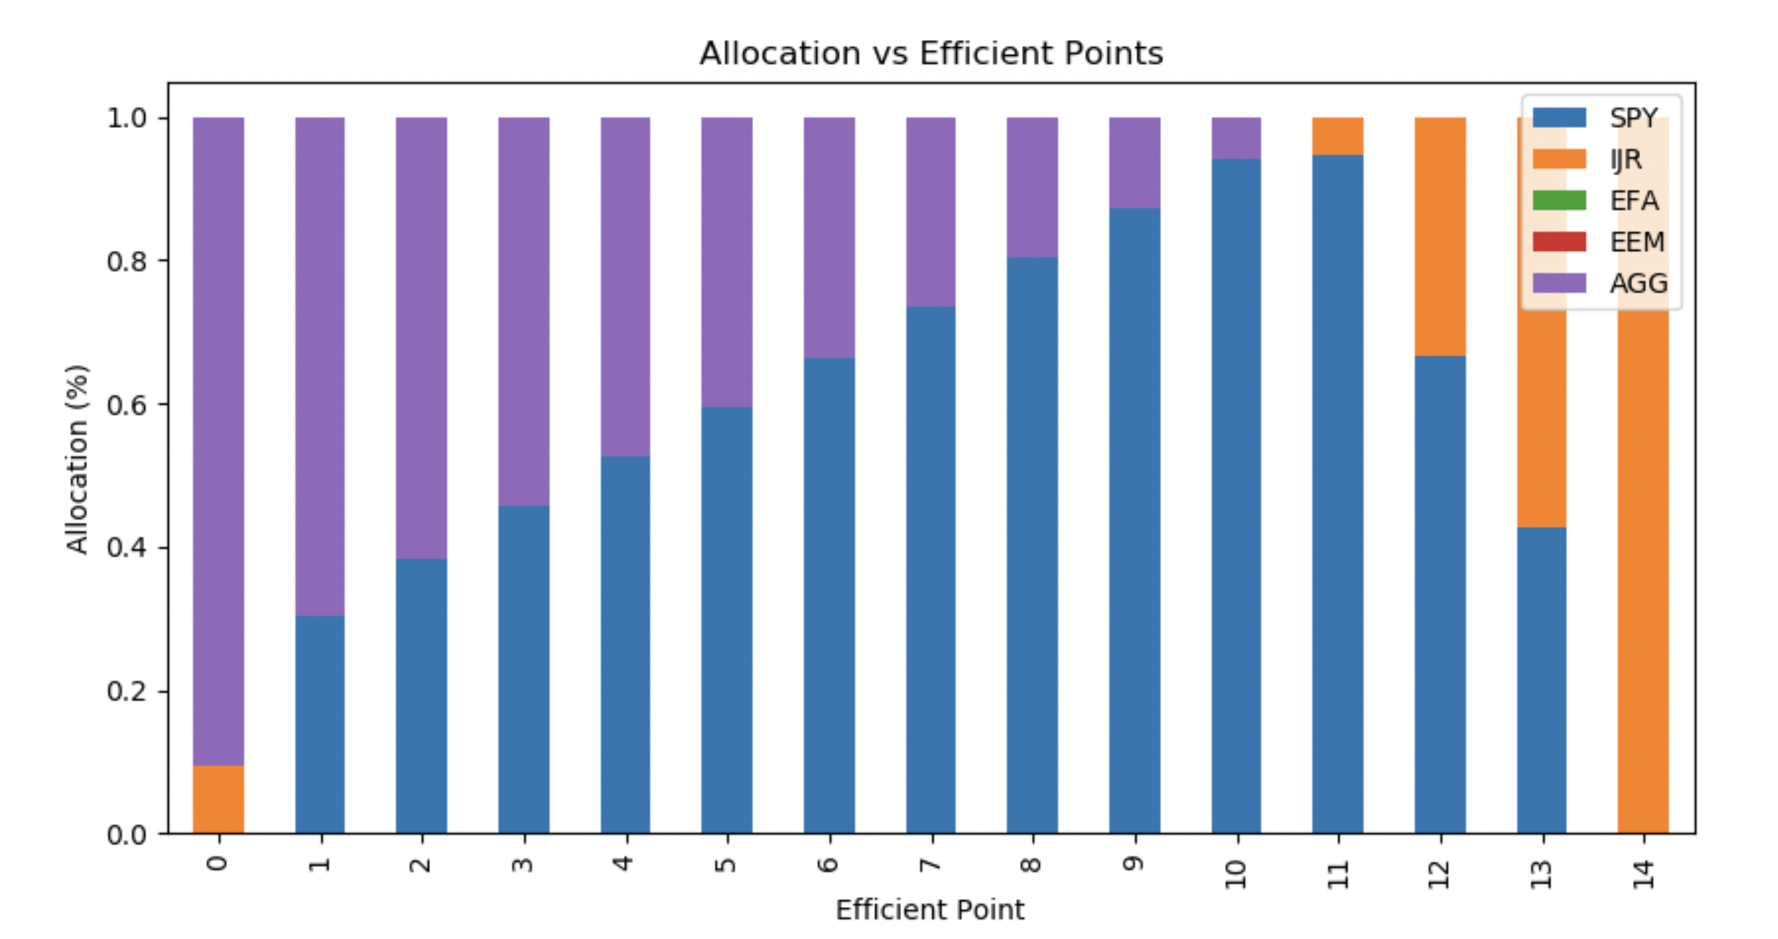
Let’s now observe the portfolio allocation for each frontier point.

Slide 21
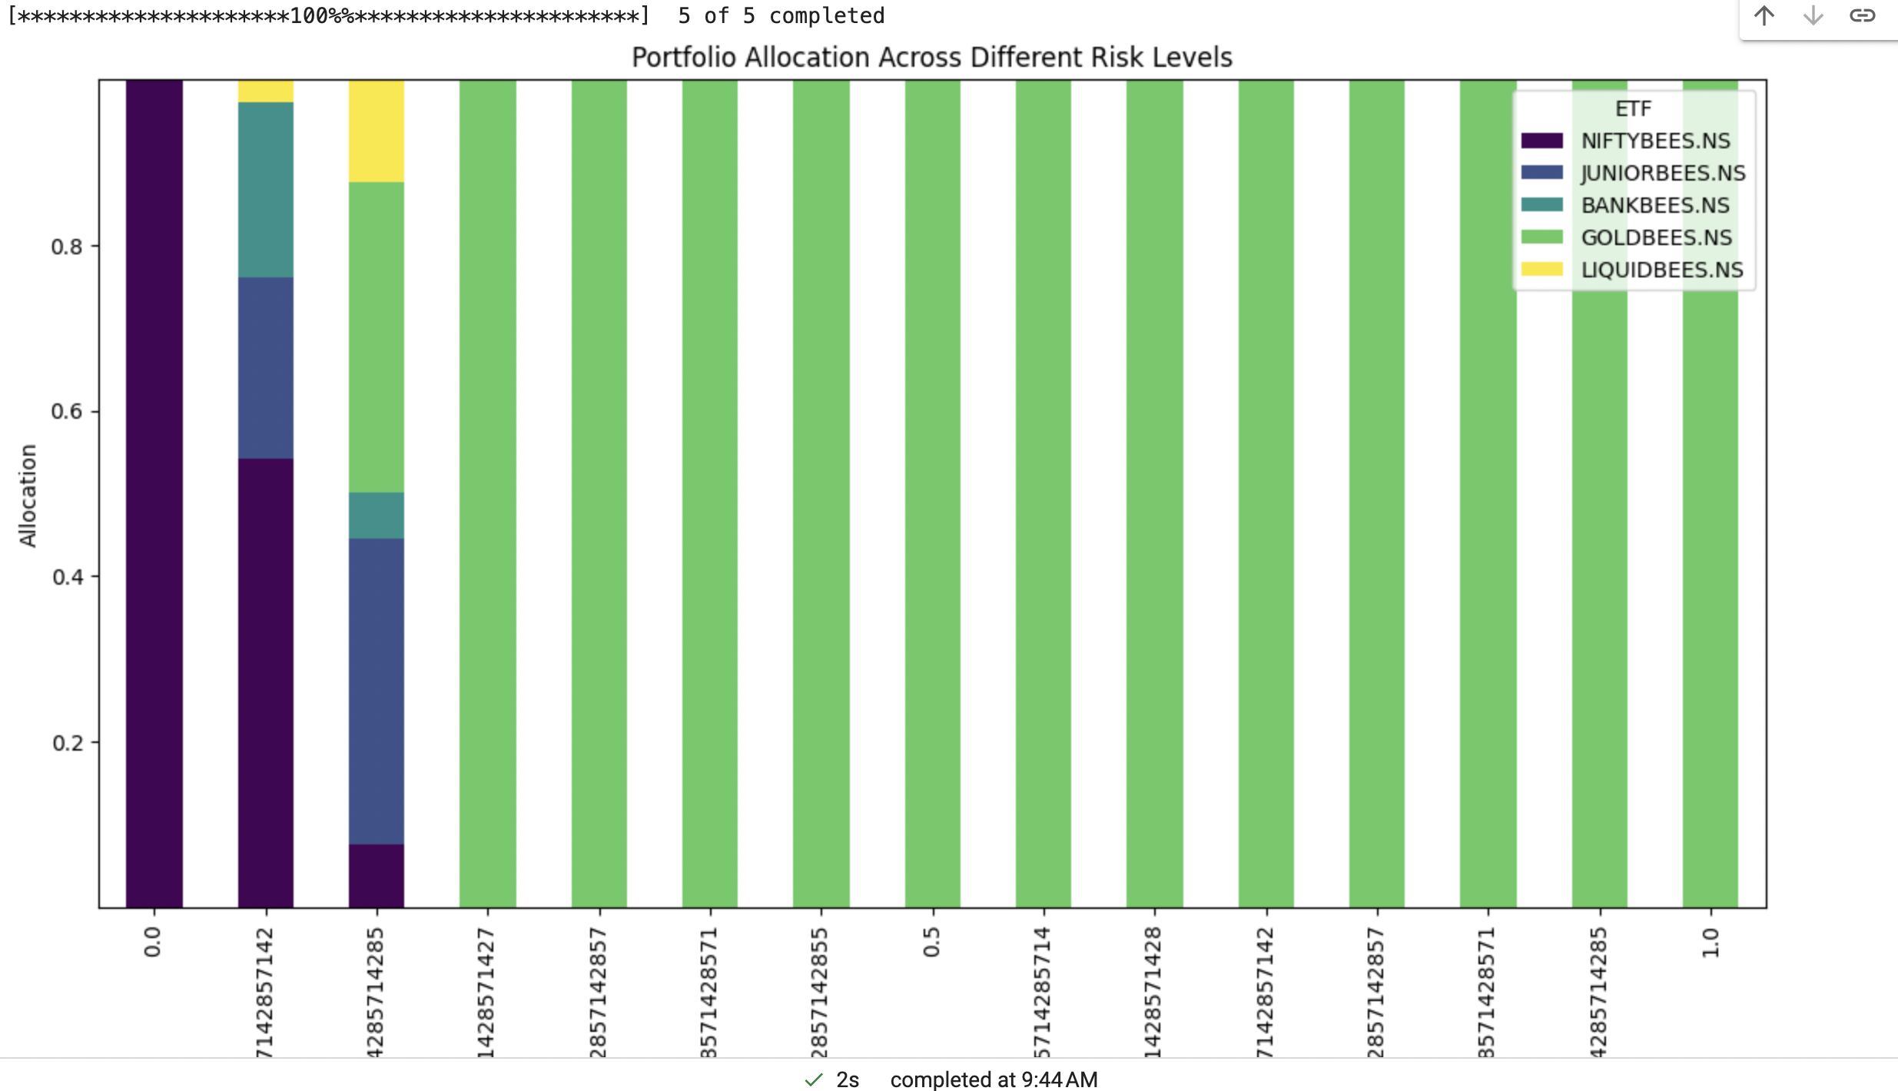

Slide 22
Construction of Uncertainty Sets .
We majorly use the approaches discussed in Data Driven Robust Optimization based on kernel Learning.
The Uncertainty Set construction would be derived from ‘Data Driven Optimization with support vector clustering ’

Slide 23
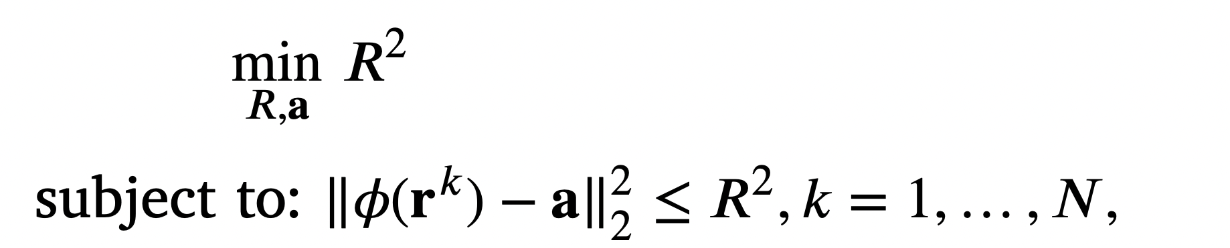
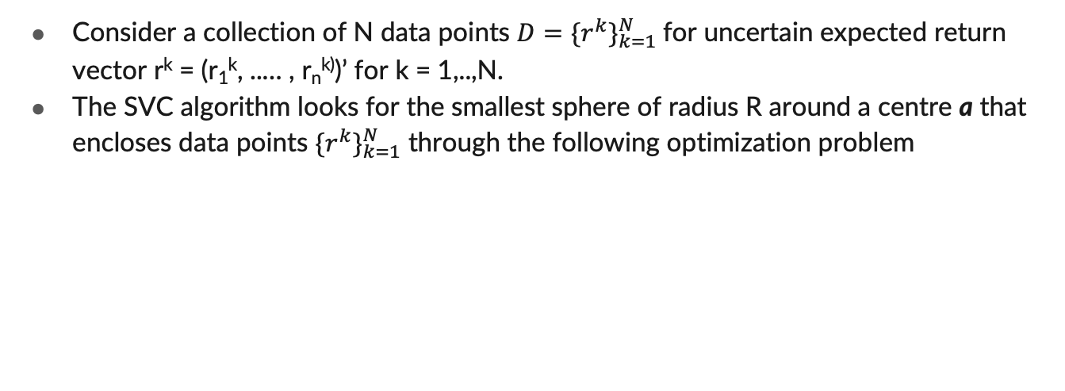
Construction of Uncertainty Sets using Support Vector Clustering
Consider a collection of N data points $D={{\{r}^{k}\}}_{k=1}^{N}$for uncertain expected return vector r^{k} = (r₁^{k}, ..… , r_{n}^{k)})’ for k = 1,..,N.
The SVC algorithm looks for the smallest sphere of radius R around a centre a that encloses data points ${{\{r}^{k}\}}_{k=1}^{N}$ through the following optimization problem

Slide 24
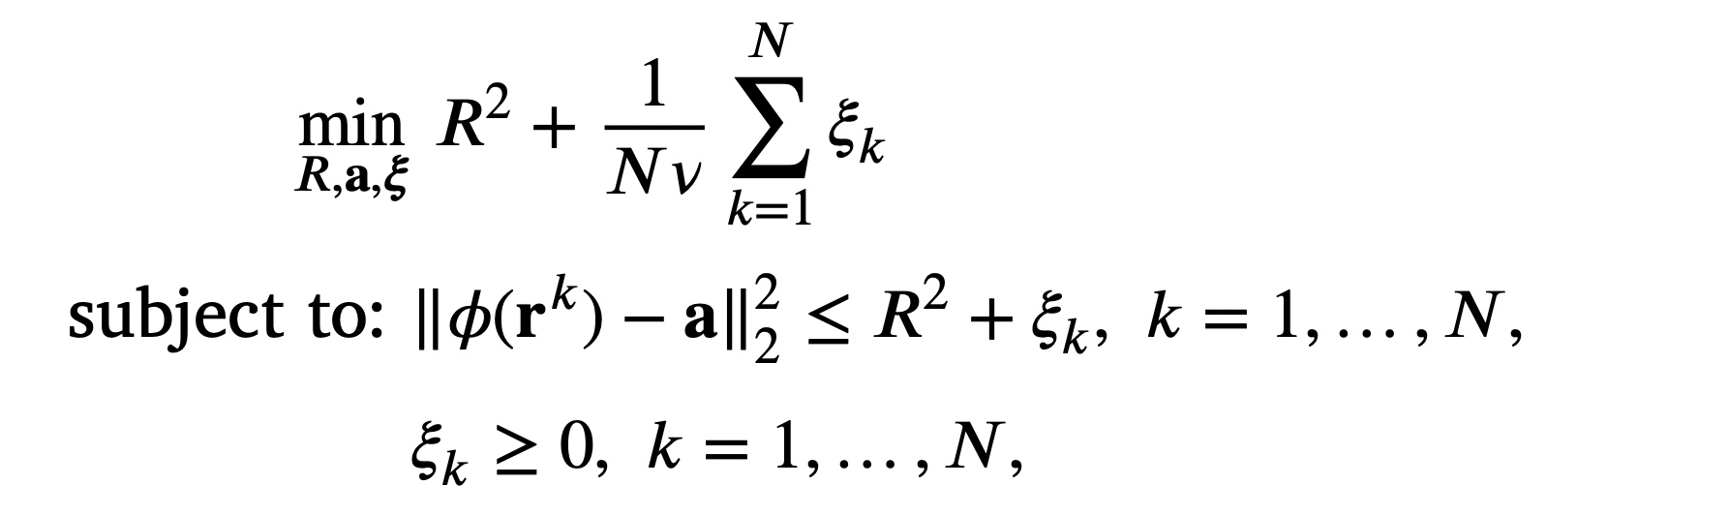

Slide 25
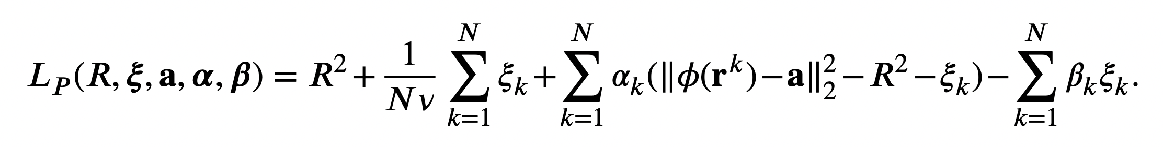

Slide 26
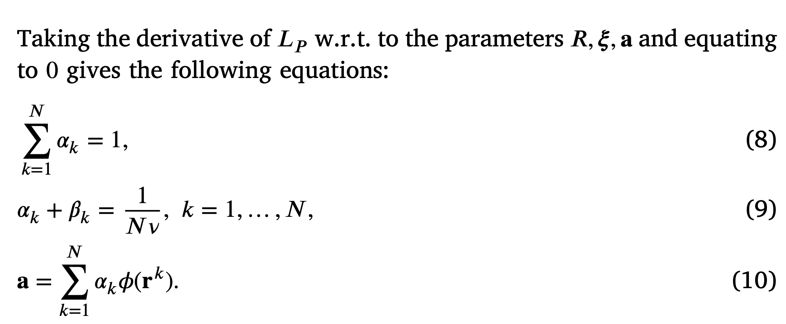

Slide 27
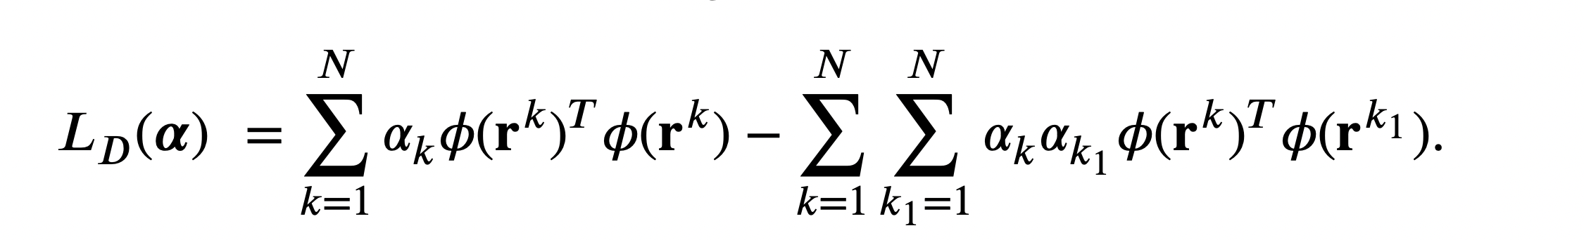

Slide 28
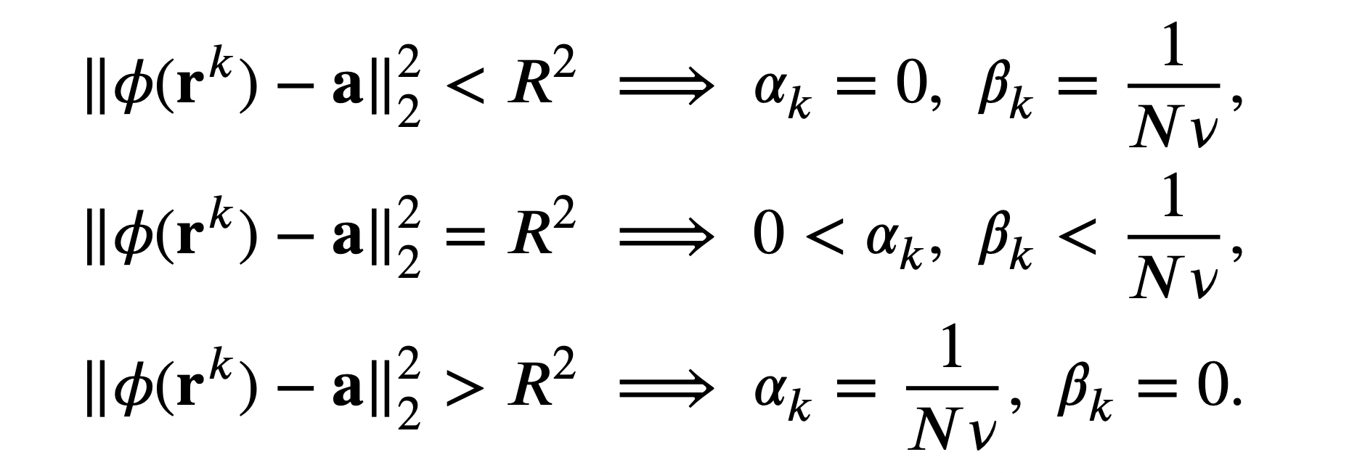
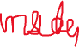


Slide 29
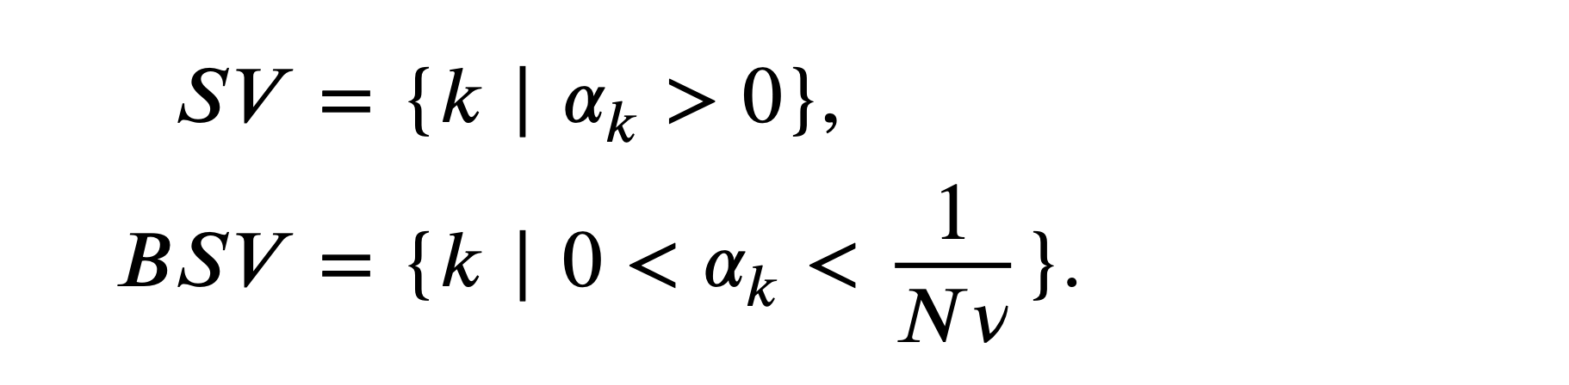
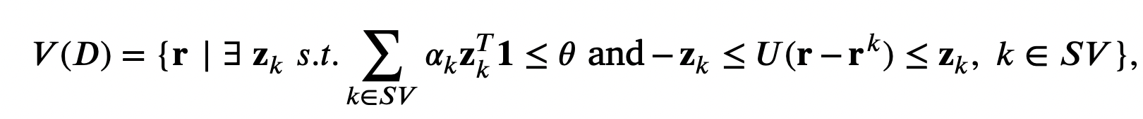

Slide 30
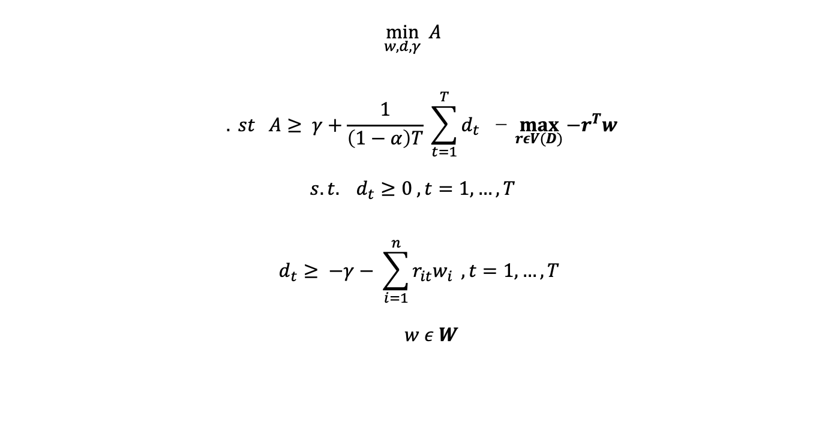
$$\min_{w,d,γ}{ A}$$
$${. st A≥ γ+\frac{1}{\left(1−α\right)T} \sum_{t=1}^{T}{d_{t } }}\text{−} \max_{rεV(D)}{−r^{T}w}$$
$$s.t. d_{t}≥0 , t=1,…, T$$
$$d_{t}≥ −γ− \sum_{i=1}^{n}{r_{it}w_{i}} , t=1,…, T$$
$w ε W$

Slide 31
Results and Analysis
The testing Methodolgy is similar to Data Driven Robust P.O. so that we can have a comparative study of the methods.
The Data was taken from AlphaVantage API which gives the daily closing returns as the last column.

Slide 32
Analysis under different market phases
We also attempt to analyse the performance of the proposed model in different market scenarios. We take the daily closing price of the market index of the EURO STOXX 50 data set and determine the period in which the following market phases are located:
Bullish (Increasing) phase: 24/12/2018–06/12/2019
• Neutral phase: 06/01/2016–29/11/2016 • Down (Decreasing) phase: 06/11/2007–20/10/2008 .
Comparison models include optimised SMAD, 1/n strategy and optimised CVaR.
ACKNOWLEDGEMENT – The codebase for SMAD and the 1/n strategy along with V(D) computation were shared by Mrs. Ruchika Sehgal. I added the CVaR strategy in it to get an accurate comparative study.

Slide 33
We conduct a rolling window analysis on the above data sets. The optimization model is solved on the in-sample period of 500 days (approximately two years) starting from January 2020, and the optimal portfolio is tested over the next 63 days (approximately three months). The out-of-sample returns are noted for these 63 days using the optimal portfolio. Then the in-sample period is shifted ahead by 63 days, and a new optimization problem is solved for the next 500 days.

Slide 34
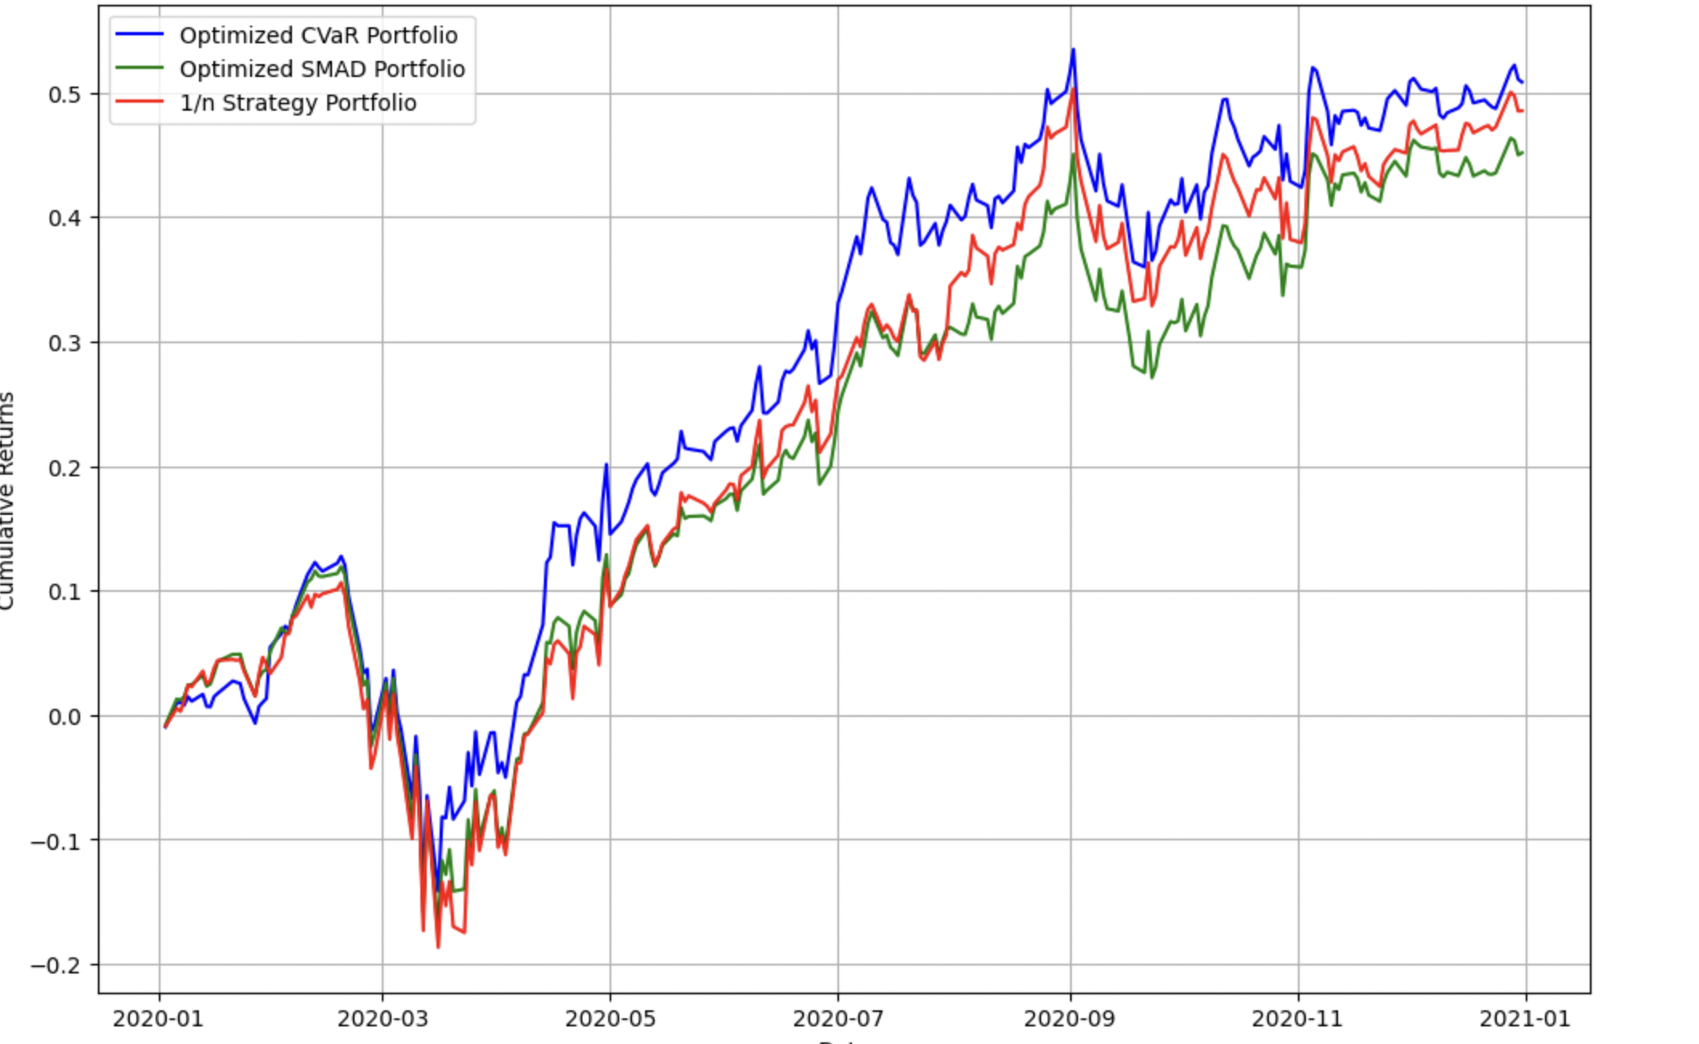

Slide 35
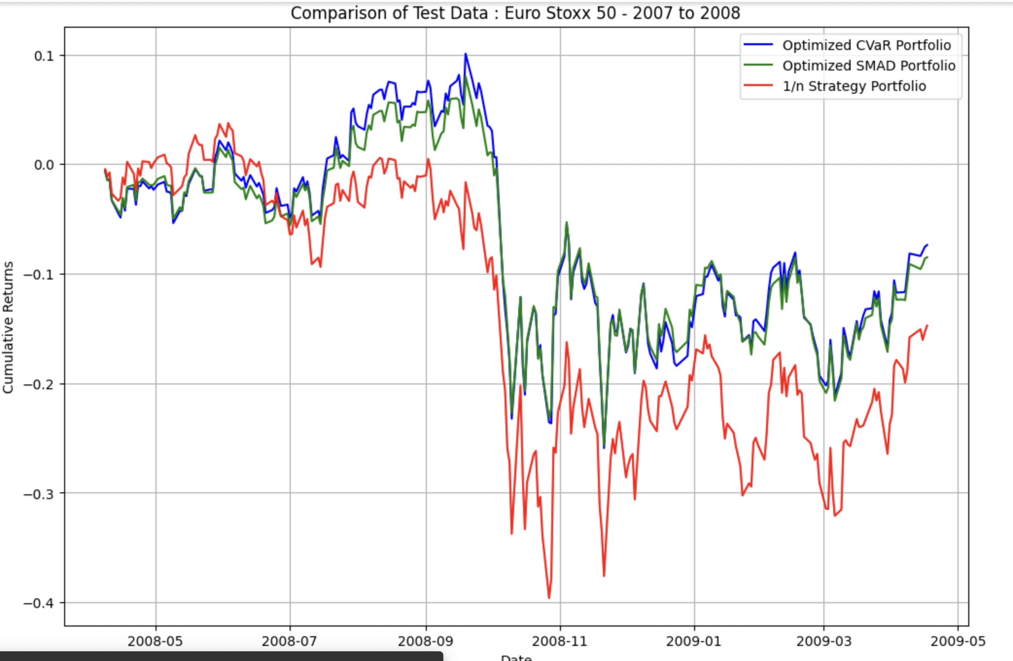
Bearish Phase

Slide 36
Performance in Bearish Phase
Downside Protection: CVaR is designed to minimize the potential losses that could occur in the worst percentage of cases. In a bearish phase, where markets are falling or expected to fall, managing these worst-case scenarios becomes crucial. CVaR effectively helps to shield the portfolio from severe downturns by focusing on the tail of the loss distribution.
Risk-focused Strategy: During bearish periods, risk management becomes a priority for most investors, especially those with a lower tolerance for risk. CVaR helps by providing a clearer picture of the potential extreme losses and ensuring that investment strategies are aligned to minimize these risks.

Slide 37
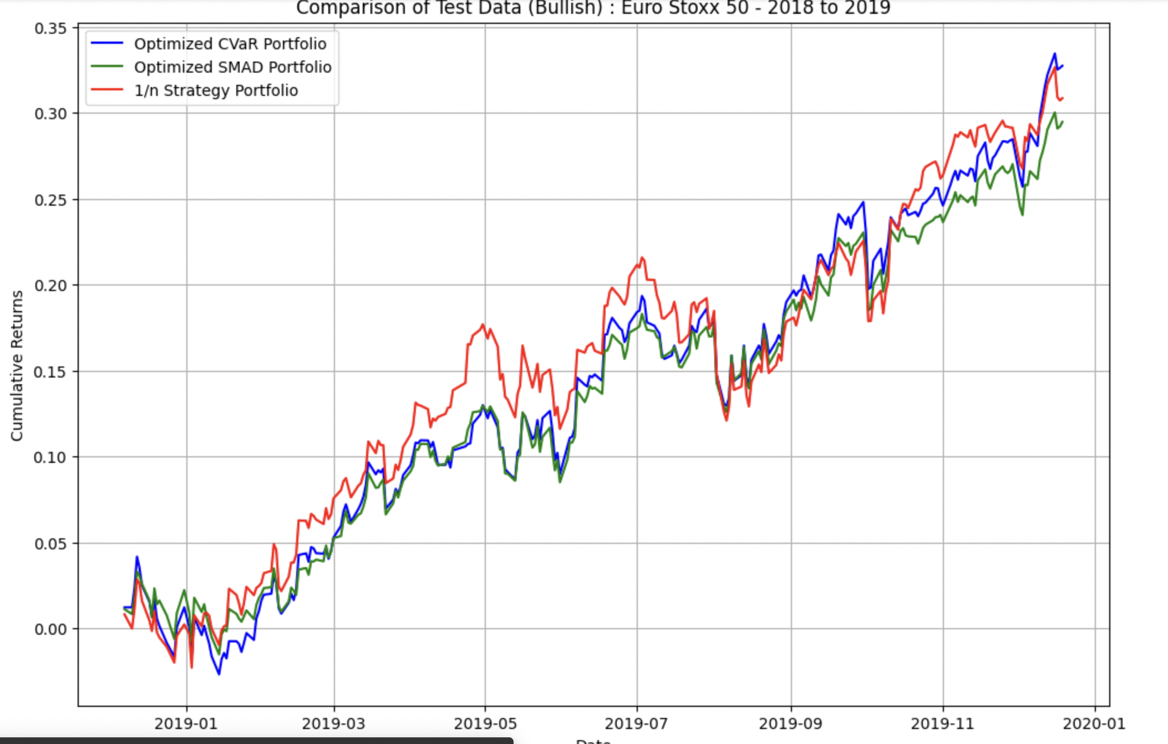
Bullish Phase

Slide 38
Performance In Bullish Phase
Opportunity Cost: While CVaR is excellent at managing downside risks, it can sometimes result in missing out on higher returns during bullish phases. This is because CVaR might lead to a more conservative portfolio that is less exposed to higher-risk, higher-return assets.
Underperformance Relative to the Market: In a rising market, a portfolio optimized for lower downside risk (as CVaR does) might not capture as much of the upside as a more aggressively positioned portfolio might. Thus, while the portfolio might experience lower volatility and smaller losses during downturns, it also might gain less during market rallies.

Slide 39
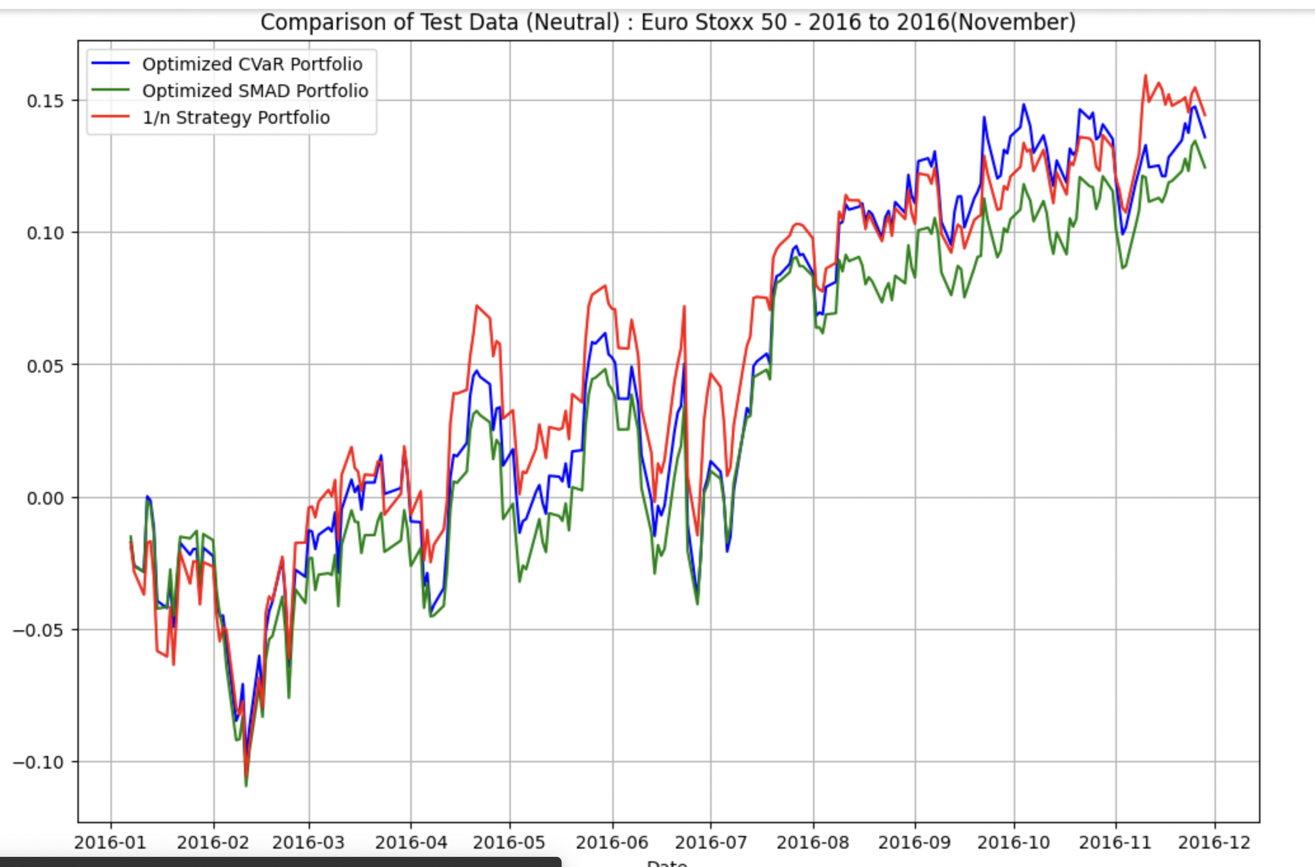
Neutral Phase

Slide 40
CVaR's utility shines in scenarios where the prevention of significant losses is crucial, making it especially suitable for bearish market phases or highly volatile conditions where the downside risks are greater. In bullish markets, while still useful, the emphasis on CVaR might be reduced to allow for greater capital appreciation. Thus, how one employs CVaR should depend on the market outlook, the investor's risk tolerance, and the specific financial goals of the portfolio.

Slide 41
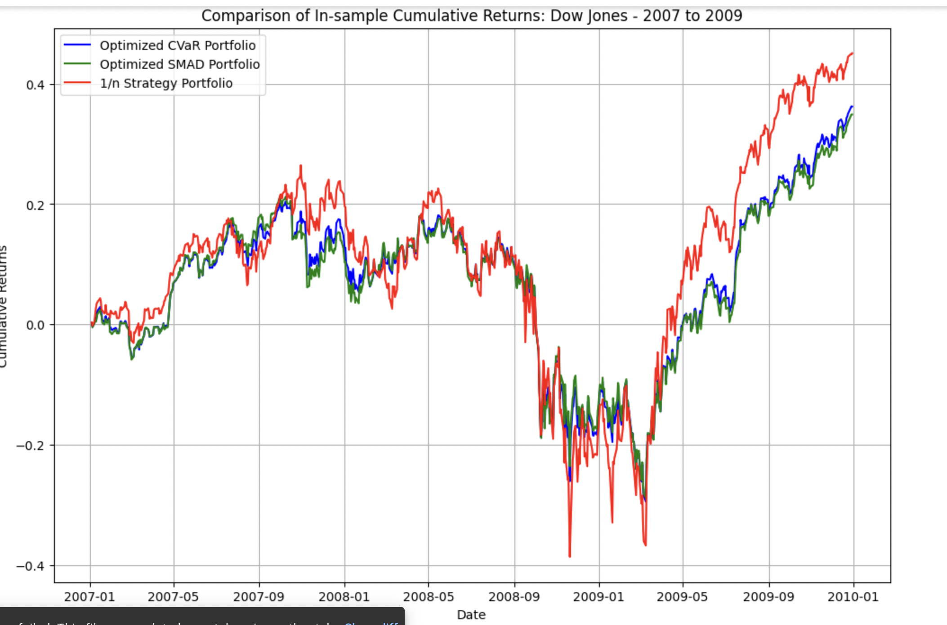
The Great Recession - Wall Street Crash

Slide 42
Lets explore Indian Markets

Slide 43
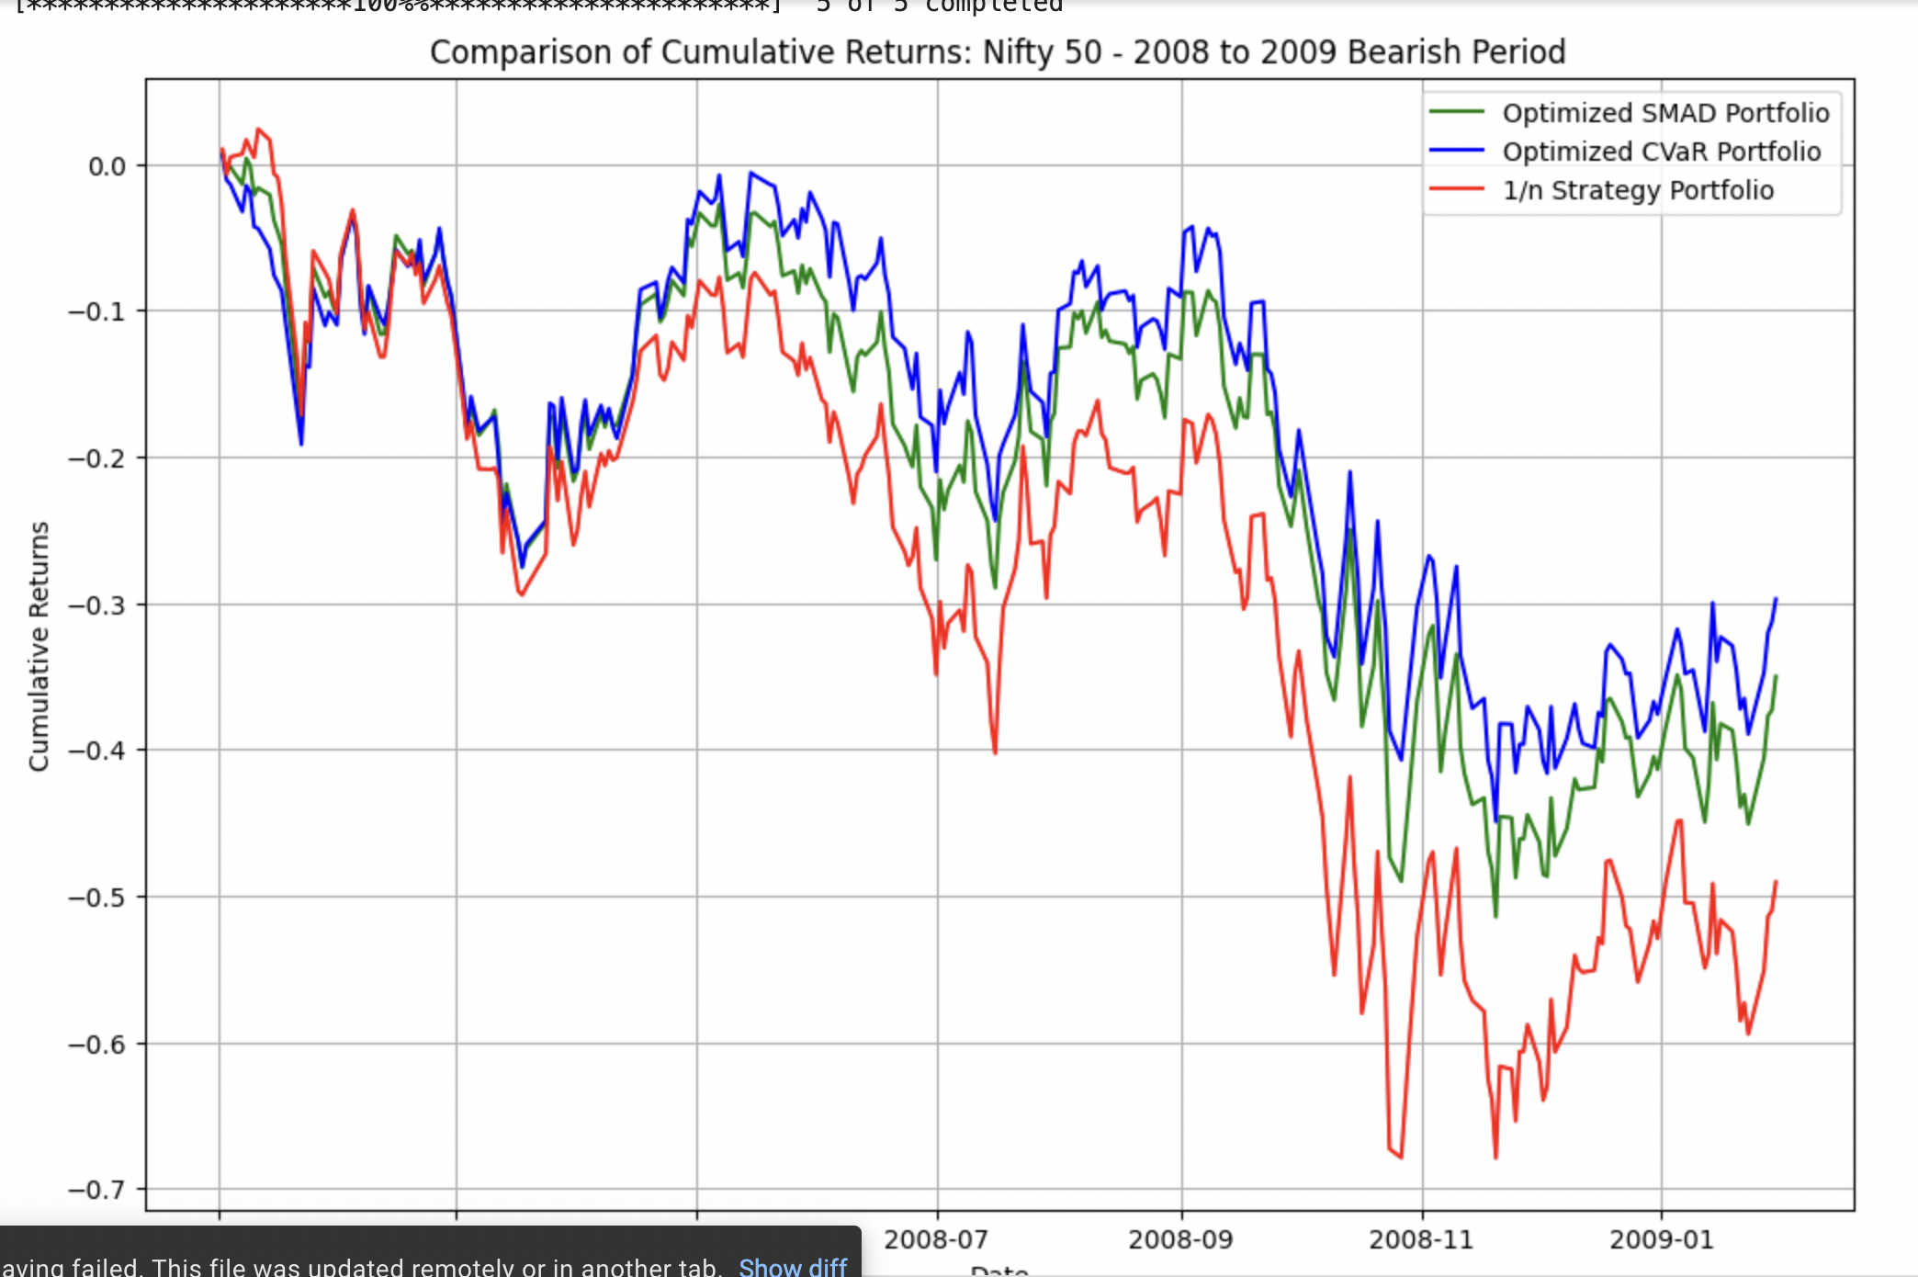
Bearish Phase

Slide 44
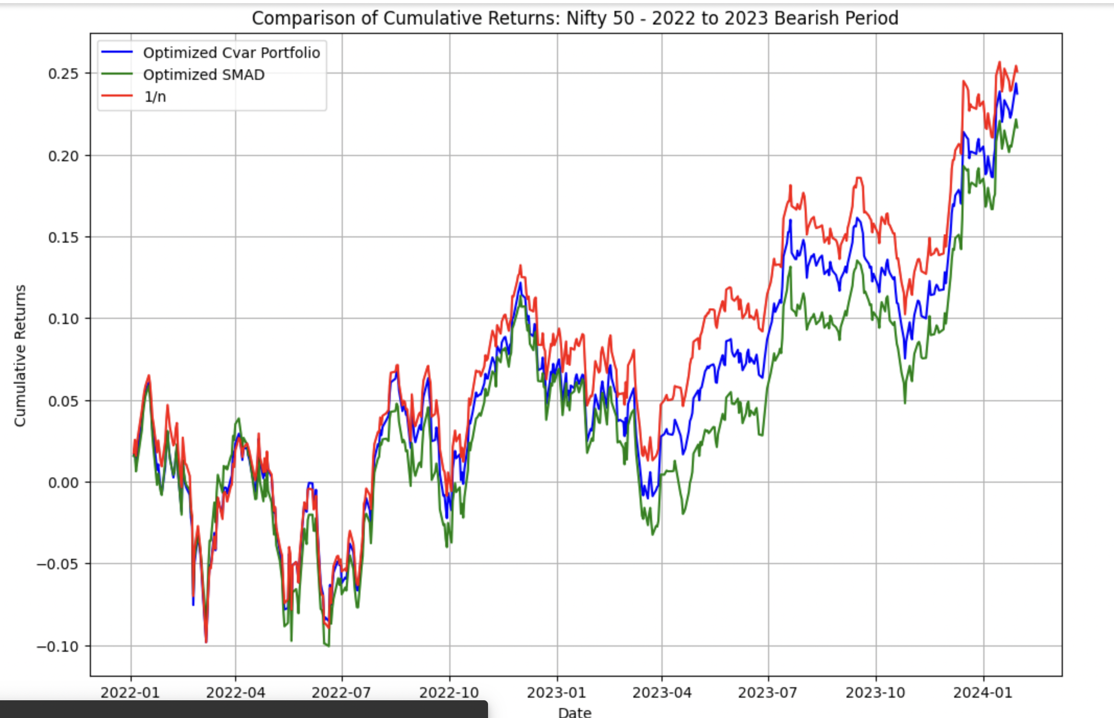
Bullish Phase

Slide 45
Thank you

